Slide 1
Lecture: Mutable Data
Week 3, Summer 2024. 7/2 (Tues)
Rev1: 2024-07-02 11:45 am PST

Slide 2
Announcements
HW04, Lab04 released today (Due: 7/8) (+2 days due to holiday)
Project01 (“Maps”) will be released on Wednesday
Partner project (though you can solo it if you’d prefer)
Holiday: no lecture/labs/OH on Thursday (July 4th)
Midterm: Wednesday, July 17th 3PM – 5PM PST (Zoom)
Alternate exam times: we’ll contact you all very soon with a form/poll to schedule alternate exam times.

Slide 3
Announcements: Weekly course surveys (optional)
(NEW) Weekly course surveys out on Gradescope
Optional, feel free to skip this.
Incentive: +0.5 bonus points per survey (“extra credit”)
These surveys helps us (the course staff) improve the course for the future, and is a great help
Each week, will be released on Gradescope at Monday (12:01 AM PST), due on Friday (11:59 PM PST). No late submissions accepted.
First one is out on Gradescope now, “Course Survey (Week 3)”

Slide 4
Lecture overview
Mutability
Identity (“is” vs “==“)
Mutable functions (aka “functions with state”)

Slide 5
Mutating Lists: Example functions of the list class
append() adds a single element to a list:
s = [2, 3]
t = [5, 6]
s.append(4)
s.append(t)
t = 0
Try in PythonTutor.
extend() adds all the elements in one list to another list:
s = [2, 3]
t = [5, 6]
s.extend(4) # 🚫 Error: 4 is not an iterable!
s.extend(t)
t = 0
Try in PythonTutor. (After deleting the bad line)

Slide 6
Mutating Lists -- More Functions!
list += [x, y, z] # just like extend.
You need to be careful with this one! It modifies the list.
pop() removes and returns the last element:
s = [2, 3]
t = [5, 6]
t = s.pop()
Try in PythonTutor.
remove() removes the first element equal to the argument:
s = [6, 2, 4, 8, 4]
s.remove(4)
Try in PythonTutor.

Slide 7
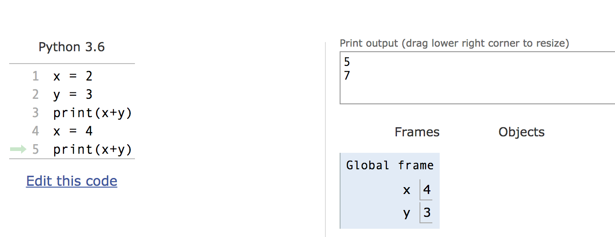
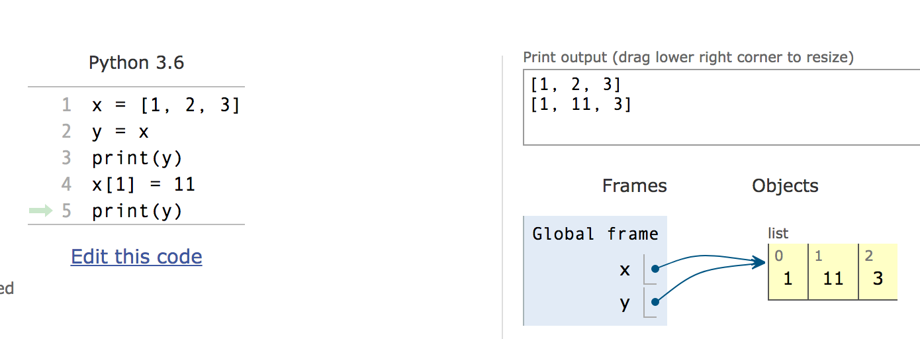
Mutation makes sharing visible
Python Tutor: Assignments Are References

Slide 8
Mutable Data Inside Immutable Objects
Mutable objects can "live" inside immutable objects!
An immutable sequence may still change if it contains a mutable value as an element.
Be very careful, and probably do not do this!
t = (1, [2, 3])
t[1][0] = 99
t[1][1] = "Problems"
Try in PythonTutor

Slide 9
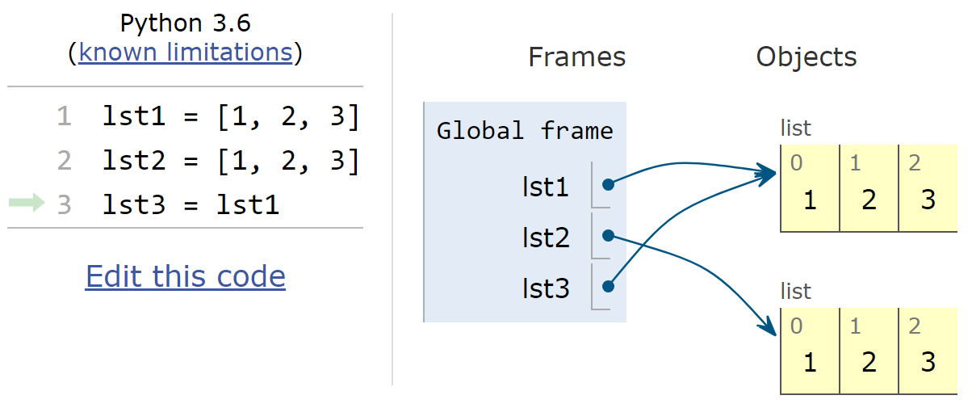
Equality vs Identity
We know how to use “==“ comparison operator to see if two things have the same value
>>> my_name = "eric"
>>> my_name == "eric” # True
With mutable objects, it’s now important to keep track of which object a variable is referencing

Slide 10
Equality vs Identity
lst1 and lst2 point to different objects, but have the same values
lst1 and lst3 point to the same object (and, as a result, have the same values)
=> Equality (lst1 == lst2)
=> Identity (lst1 is lst3)
Aka “Value equality”
Aka “Identity equality”

Slide 11
Copies, 'is' and '=='
Identity and == vs is
How do we know if two names (variables) are the same exact object? i.e. Will modifying one modify the other?
>>> alist = [1, 2, 3, 4]
>>> alist == [1, 2, 3, 4] # Equal values?
True
>>> alist is [1, 2, 3, 4] # same object?
False
>>> blist = alist # assignment refers
>>> alist is blist # to same object
True
>>> blist = list(alist) # type constructors copy
>>> blist is alist
False
>>> blist = alist[ : ] # so does slicing
>>> blist is alist
False
>>> blist
[1, 2, 3, 4]
>>>

Slide 12
What is the meaning of is?
How does Python implement the `is` operator?
Intuitive (visual) answer: `a is b` is True iff `a` points to the same exact object as `b` points to.
>>> lst1 is lst2
False
>>> lst1 is lst3
True

Slide 13
What is the meaning of is?
How does Python implement the `is` operator?
Technical answer: `a is b` is True iff `a` points to the same memory address as `b` points to.
>>> lst1 = [1, 2, 3]
>>> lst2 = [1, 2, 3]
>>> lst3 = lst1
>>> id(lst1)
1906951142144
>>> id(lst2)
1906951128448
>>> id(lst3)
1906951142144
>>> lst1 is lst2
False
>>> lst1 is lst3
True
>>> id(lst1) == id(lst2)
False
>>> id(lst1) == id(lst3)
True
These are memory addresses! Eg somewhere in your CPU RAM
Tip: think of RAM as a long array/list, and an address as an index into the list.
Thus, the `is` operator is actually comparing memory addresses behind the scenes.

Slide 14

Python’s `id()` function
In Python, each object has a function id() which returns its “memory address“
CPU memory (random access memory, aka “RAM”)
Example: In 2024, a Macbook Pro 14” has 8 GB - 36 GB CPU RAM
Aside: GPU (graphical processing units) have their own separate GPU memory. State-of-the-art ML models (like ChatGPT, etc) are notoriously GPU-memory intensive
Bill Gates once said* in 1981 “640K of memory should be enough for anybody.”
* Not actually true, but it makes a funny story
Think this is cool? amazing?
Related courses: CS61C (Architecture), CS162 (Operating Systems), CS164 (Programming Languages and Compilers)
Credit: https://www.techspot.com/article/2024-anatomy-ram/

Slide 15
Passing Data Into Functions

Slide 16
Learning Objectives
Passing in a mutable object in a function in Python lets you modify that object
Immutable objects don't change when passed in as an argument
Making a new name doesn't affect the value outside the function
Modifying mutable data does modify the values in the parent frame.

Slide 17
Mutating Arguments
Functions can mutate objects passed in as an argument
Declaring a new variable with the same name as an argument only exists within the scope of our function
You can think of this as creating a new name, in the same way as redefining a variable.
This will not modify the data outside the function, even for mutable objects.
BUT
We can still directly modify the object passed in…even though it was created in some other frame or environment.
We directly call methods on that object.
View Python Tutor

Slide 18
Understanding Python: What should we return?
Why do some functions return None?
Why do some functions return a value?
Convention: Functions that mutate an argument usually return None!
C88C / 61A / Data Science View: Avoid mutating data unless it's necessary!
Mutations are useful, but can get confusing quickly. This is why we focus on functional programming - map, filter, reduce, list comprehensions, etc.

Slide 19
Functions that Mutate vs Return New Objects
Lists:
sorted(list) – returns a new list
list.sort() – modifies the list, returns None
list.append() – modifies the list, returns None
list.extend() – modifies the list, returns None
The fact that these return None are a strong hint that these functions mutate the object (“in place” modification”)
How to be sure? Read the function documentation.

Slide 20
Python Gotcha's: a += b and a = a + b
Sometimes similar looking operations have very different results!
Hint: = always binds (or re-binds) a value to a name.
Python Tutor
def add_data_to_thing(thing, data):
print(f"+=, Before: {thing}")
thing += data
print(f"+=, After: {thing}")
return thing
def new_thing_with_data(thing, data):
print(f"=, Before: {thing}")
thing = thing + data
print(f"=, After: {thing}")
return thing
Main takeaway:
For lists, the `lst += thing` operator is NOT the same as `lst = lst + thing`.
Instead, list’s `+=` operator is an in-place modification of the LHS.
Tip: `lst += thing` calls the list.__iadd__() function, which performs the in-place modification.

Slide 21
Mutable Functions

Slide 22
Learning Objectives
Remember: Each function gets its own new frame
Inner functions can access data in the parent environment
Use an inner function along with a mutable data type to capture changes

Slide 23
Putting it all together: a Counter
Applying everything we’ve learned, we’re now ready to implement a Counter function
It will “remember” its state, and each time we call it, will increment its internal counter value
# Desired usage
>>> counter = make_counter()
>>> counter()
1
>>> counter()
2
>>> counter()
3
def make_counter():
# IMPLEMENT ME
pass
Question: how to finish the `make_counter()` definition?

Slide 24
Putting it all together: a Counter
Applying everything we’ve learned, we’re now ready to implement a Counter function
It will “remember” its state, and each time we call it, will increment its internal counter value
# Desired usage
>>> counter = make_counter()
>>> counter()
1
>>> counter()
2
>>> counter()
3
def make_counter():
my_state = [0]
def count_up():
my_state[0] += 1
return my_state[0]
return count_up
Python Tutor link
Tip: step through the Python Tutor visualization to see what’s going on!

Slide 25
Putting it all together: a Counter
Here is an alternate implementation. What Would Python Print?
def make_counter():
my_state = [0]
def count_up():
my_state.append(my_state[-1] + 1)
return my_state[-1]
return count_up
>>> counter = make_counter()
>>> counter()
# FILL ME IN
>>> counter()
# FILL ME IN
>>> counter()
# FILL ME IN

Slide 26
Putting it all together: a Counter
Here is an alternate implementation. What Would Python Print?
def make_counter():
my_state = [0]
def count_up():
my_state.append(my_state[-1] + 1)
return my_state[-1]
return count_up
>>> counter = make_counter()
>>> counter()
1
>>> counter()
2
>>> counter()
3
It works! Hooray.
Question: what is one downside to this implementation?

Slide 27
Putting it all together: a Counter
Here is an alternate implementation. What Would Python Print?
def make_counter_v2():
my_state = [0]
def count_up():
my_state.append(my_state[-1] + 1)
return my_state[-1]
return count_up
>>> counter = make_counter_v2()
>>> counter()
1
>>> counter()
2
>>> counter()
3
It works! Hooray.
Question: what is one downside to this implementation?
Answer: the `my_state` list will grow for each call. If we call it many times, the memory usage may grow too high and crash the machine (“CPU out of memory”).

Slide 28
Putting it all together: a Counter
With the same implementation, What Would Python Print?
def make_counter_v2():
my_state = [0]
def count_up():
my_state.append(my_state[-1] + 1)
return my_state[-1]
return count_up
>>> make_counter_v2()()
# FILL ME IN
>>> make_counter_v2()()
# FILL ME IN

Slide 29
Putting it all together: a Counter
With the same implementation, What Would Python Print?
def make_counter_v2():
my_state = [0]
def count_up():
my_state.append(my_state[-1] + 1)
return my_state[-1]
return count_up
>>> make_counter_v2()()
1
>>> make_counter_v2()()
1
It doesn’t work! Gasp.
Root cause: each call to `make_counter_v2()` creates a NEW `count_up()` function with a fresh `my_state = [0]`.
Not following? Try following the Python Tutor visualization.

Slide 30
Functions with state: Bank account
Goal: Use a function to repeatedly withdraw from a bank account that starts with $100.
Build our account: withdraw = make_withdraw_account(100)
First call to the function:
withdraw(25) # 75
Second call to the function:
withdraw(25) # 50
Third call to the function:
withdraw(60) # 'Insufficient funds'

Slide 31
How Do We Implement Bank Accounts?
A mutable value in the parent frame can maintain the local state for a function.
View in PythonTutor
def make_withdraw_account(initial):
balance = [initial]
def withdraw(amount):
if balance[0] - amount < 0:
return 'Insufficient funds'
balance[0] -= amount
return balance[0]
return withdraw

Slide 32
Implementing Bank Accounts
A mutable value in the parent frame can maintain the local state for a function.
def make_withdraw_account(initial):
balance = [initial]
def withdraw(amount):
if balance[0] - amount < 0:
return 'Insufficient funds'
balance[0] -= amount
return balance[0]
return withdraw
View in PythonTutor

Slide 33
Aside: Counters and nonlocal/global
Here is another implementation. What Would Python Print?
def make_counter():
my_state = 0
def count_up():
my_state = my_state + 1
return my_state
return count_up
>>> counter = make_counter()
>>> counter()
# FILL ME IN
>>> counter()
# FILL ME IN
>>> counter()
# FILL ME IN

Slide 34
Aside: Counters and nonlocal/global
Here is another implementation. What Would Python Print?
def make_counter():
my_state = 0
def count_up():
my_state = my_state + 1
return my_state
return count_up
>>> counter = make_counter()
>>> counter()
Traceback (most recent call last):
File "<stdin>", line 1, in <module>
File "<stdin>", line 4, in count_up
UnboundLocalError: local variable 'my_state' referenced before assignment
Woah. What is going on here?
Due to language design decisions, Python does not let you re-bind variables that exist in parent frames (including the global frame).
For a more detailed explanation straight from the Python3 docs, see this link.

Slide 35
Aside: Counters and nonlocal/global
One way to fix this is to use the nonlocal keyword
def make_counter_v3():
my_state = 0
def count_up():
nonlocal my_state
my_state = my_state + 1
return my_state
return count_up
>>> counter = make_counter()
>>> counter()
1
>>> counter()
2
`nonlocal my_state` tells Python that the `my_state` variable refers to a variable in a parent (non-local) frame, and any assignments should modify the variable in the OTHER frame.

Slide 36
Aside: Counters and nonlocal/global
There’s an analogous keyword for global vars, `global`
a_global_var = 42
def fn():
global a_global_var
a_global_var = 9000
>>> print(f"Before fn(): {a_global_var}")
Before fn(): 42
>>> fn()
>>> print(f"After fn(): {a_global_var}")
After fn(): 9000

Slide 37
In Data C88C su24: nonlocal, global
In this class (Data C88C Summer 2024), we will NOT be using the Python keywords: `nonlocal`, `global`
For assignments/exams, we won’t expect you to use nonlocal/global
But, we will expect you to understand why the below errors
def make_counter():
my_state = 0
def count_up():
my_state = my_state + 1
return my_state
return count_up
>>> counter = make_counter()
>>> counter()
Traceback (most recent call last):
File "<stdin>", line 1, in <module>
File "<stdin>", line 4, in count_up
UnboundLocalError: local variable 'my_state' referenced before assignment

Slide 38
Aside: Counters and nonlocal/global
(review) What Would Python Print?
a_global_var = 42
def fn():
a_global_var = 9000
>>> print(f"Before fn(): {a_global_var}")
42
>>> fn()
>>> print(f"After fn(): {a_global_var}")
# FILL ME IN

Slide 39
Aside: Counters and nonlocal/global
(review) What Would Python Print?
This creates a new variable `a_global_var` in the fn2 frame, with value 9000. Notably, this `a_global_var` shadows the `a_global_var` at the global frame.
Visualization: Python Tutor
a_global_var = 42
def fn2():
a_global_var = 9000
>>> print(f"Before fn(): {a_global_var}")
42
>>> fn2()
>>> print(f"After fn(): {a_global_var}")
42

Slide 40
Lecture overview. Any questions?
Mutability
Identity (“is” vs “==“)
Mutable functions (aka “functions with state”)

